Slide 1
A strategic lens to climate smart aid and trade focused food and nutrition security interventions
By: Dutch Sustainability Unit, November 2016
Building on the DSU-report : http://dsu.eia.nl/publications/advisory-reports/7184

Slide 2
Why this DSU-advice
DGIS looking for a practical method to take climate change into consideration from the start of portfolio development.
The method should focus on budgets earmarked for food security objectives (SDG2 and SDG3), and, at the same time, objectives of climate change (SDG13).
The method doesn’t have to be perfect, but should, in a practical way, inform strategic decisions about where to invest future FNS budgets in accordance with the more general aid and trade and inclusive green growth agendas.
Focus should be primarily on climate change adaptation rather than climate change mitigation, as adaptation has a closer link to food production and therefore indirectly to accommodation-in-the-region of refugees and prevention of migration.

Slide 3
The issue
Where to focus interventions with a view to food systems in places where that creates most food security (SDG2) in view of climate change vulnerability (SDG13) and (nearby) conflict (SDG16)?
Interventions
NL (or other donors and
international investors)
Sustainable
Development
impacts
(Inter)national
Economic systems
Climate impact SDG 13
Priority: Adaptation
Other SDGs, ip
1 No poverty,
2 No hunger
3 Good health
5 Gender equality
6 Clean energy
8 Decent work
9 Industry
10 Less inequality
11 Sustainable cities
12 Responsible
value chains
13 Climate mitigation
15 Life on land
16 peace, justice ..
Bilateral ODA
Multilateral ODA
Private investments
Food systems
smart simplification
required
Climate refugees,
Migration Several SDGs

Slide 4
Climate change adaptation action:
Intends to reduce the vulnerability of people or ecosystems to the current and expected impacts of climate change, including climate variability. It consists of actions to:
    maintain or increase resilience through increased ability to adapt to, or absorb climate change stresses, shocks and variability
    help reduce exposure to climate change stresses, shocks and variability
Source: DGIS guidelines for integrating climate-smart actions into development activities (Draft 30/10/2016)

Slide 5
Climate vulnerability: key factors
Location – some areas are more vulnerable to the effects of climate change than others
Diversity of livelihoods and resources - diversity of resources (income, land, savings) increases the capacity for coping and adapting to climate change. The more resources the lower the vulnerability, especially if less at risk from the effects of climate change. The less resources, the higher the vulnerability. This explains why the poorest (those with limited or no access to resources and income) are the most vulnerable.
Gender - Gender influences the dynamics of vulnerability. (…)
Source: DGIS internal guidelines for integrating climate-smart actions into development activities (Draft 30/10/2016)

Slide 6
The concept introduced

Slide 7
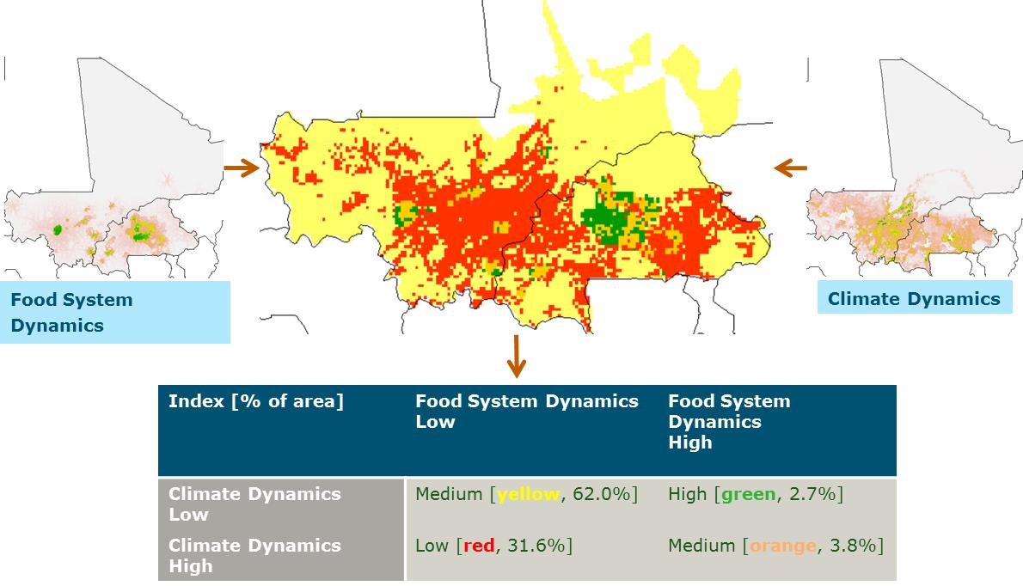
The “smart simplification” concept, operationalized
Areas with high, medium and low potential for climate smart interventions into food systems

Slide 8
What does “high potential” mean?
“High potential” are areas where leverage of interventions is highest in terms of food production and economic output
“High potential areas” are assumed to have both:
    High dynamics of food systems (e.g. population growth and growing production)
    Low climate dynamics (less vulnerable to climate change)
  Assumption behind “inclusive green growth” and “aid to trade” policies is that populations from lower potential areas may benefit indirectly through e.g.:
    radiating multiplier effects, internal migration, or social safety nets

Slide 9
Informing strategic portfolio decisions
  Focusing on these high potential areas, in the above definition, may contribute to the climate resilience of the region as a whole if populations in nearby lower potential areas profit as well. Designing the portfolio intentionally in this way might be considered climate smart and perhaps “principal” according to Rio Markers.
  However, alternatively, “high potential areas” may (e.g.) be defined as those that have high climate dynamics and low food system dynamics. Many vulnerable people live here. They may also be more difficult to help. Interventions may not lead to livelihoods that sustain in the long term. Also growth and trade may profit less. But these things cannot easily be generalized.
  In any case, the method permits discussion about such possible assumptions, enabling informed portfolio choices. Another source are the climate change profiles of partner countries (downloadable at www.dsu.eia.nl)

Slide 10
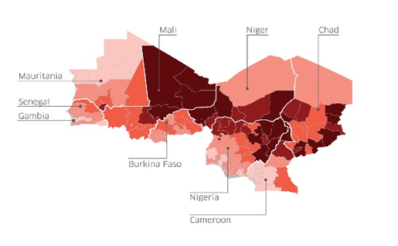
Linking potential to refugees
Among “high potential areas” one may prioritize areas that are close to potential conflict areas that may benefit from the nearby presence of a “food basket”
This distance could not be integrated into GIS-map and needs to be taken from ad hoc sources, forecasting indirect benefits by expert judgment. In that judgement, experts should take climate change itself into consideration as one exacerbating factor behind conflict. (e.g. ND-GAIN index).
The indirect effect on risk of migration to Europe is
hard to assess. However, in the long term,
“green growth” in the region probably will reduce
that risk as well.

Slide 11
The concept further explained

Slide 12
System levels we may intervene in
Interventions at Food System Level:
    which food systems (high potential areas) to address (programme location)?
  Interventions at Value chain level:
    how to address the enabling environment of these food systems? (programme enabling activities)
  Interventions at Farming Systems level:
    how to address the choice of farming systems within food systems? (programme activities)
  Interventions that do not affect the other 3 system levels above :
    how to fine-tune programmes with given location and activities in order to cope with climate change?
Lens 2
Lens 1
  See also “climate lens 1 project” see http://dsu.eia.nl/publications/advisory-reports/7136)

Slide 13
Eligibility under OECD Rio Markers (revised 2016)
  “An activity (DSU: intervention) is adaptation-related if it intends to reduce the vulnerability of human or natural systems to the current and expected impacts of climate change, including climate variability, by maintaining or increasing resilience, through increased ability to adapt to, or absorb, climate change stresses, shocks and variability and/or by helping reduce exposure to them. This encompasses a range of activities from information and knowledge, generation, to capacity development, planning and the implementation of climate change adaptation actions.”
  “An activity is eligible to the marker if the climate change adaptation objective is explicitly indicated in the activity documentation; and the activity contains specific measures targeting the definition above.”

Slide 14
The two spatial determinants
Food system dynamics:
    Expected leverage (relevant conditions: nearby food demand, ongoing urbanization, infrastructure/access, etc)
Climate dynamics:
    Climate vulnerability: a changing climate + susceptible to being adversely affected (relevant conditions: water availability, temperature, agricultural land use, quality of governance ..)

Slide 15
Four types of areas with names from green growth / aid to trade perspective

Slide 16
Food system dynamics: available proxies
(10 km x 10 km, open source, worldwide)
Proxy composed of:
    Urban / rural regions
    Market access

Slide 17
Climate dynamics: available proxies
(10 km x 10 km, open source, worldwide)
  Proxy composed of
    Water availability (based on precipitation; irrigation, drought risk, proximity of rivers and lakes)
    Agricultural land use (Share of cropland, Cattle density, Share of pastures)
    The combination of water availability and current agricultural land use is assumed to be an adequate first-order estimate of climate vulnerability of the production system. It uses the observed standard deviation of precipitation as measure of climate variability that may be aggravated in the future and then may exceed threshold values, causing climate shocks to the production system. Combined with the accumulated water availability and the type of production (agricultural land use) we have a measure for vulnerability to exceeding of such threshold values. As it is a first-order estimate, it always has to be checked against reality on the ground. In the future, as drilled down and regularly updated climate scenarios become available, it may be possible to refine the risk estimates.

